Slide 1
Courses Usage And History Dataset
CROSS VALIDATION
LINEAR REGRESSION WITH MULTIPLE VARIABLE
LOGISTIC REGRESSION

Slide 2

CROSS VALIDATION
Cross validation is used to evaluate machine learning models on limited data.
It ensures that the model generalizes well and isn’t overly fitted to the training data.
In our dataset 5-fold-cross-validation is used:-
cv_scores=cross_val_score(model,X_train,y_train,cv=5,scoring='neg_mean_squared_error’)
The dataset (in this case, the training set `X_train` and `y_train`) is split into 5 equal-sized "folds." The model is trained on 4 of these folds, and the 5th fold is used for validation. This process is repeated 5 times, with each fold serving as the validation set once.
MSE Scoring: You're evaluating the model using the Mean Squared Error (MSE) as the scoring metric. The negative MSE is converted back to positive for easier interpretation.
Final Model Training: After cross-validation, the model is trained on the entire training set (`X_train`) and tested on the test set (`X_test`) to get the final evaluation using MSE on the unseen data.
Thus, this code performs 5-fold cross-validation to assess the model's performance during training and helps estimate how well the model is likely to perform on unseen data.

Slide 3
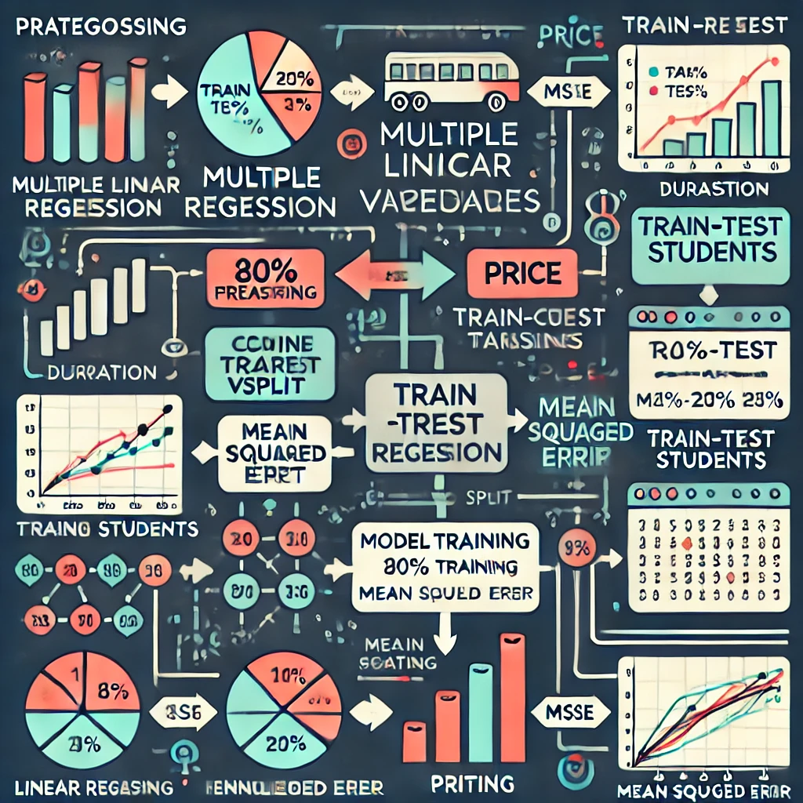
LINEAR REGRESSION WITH MULTIPLE VARIABLE
1. Load and Preprocess Data:
- The dataset is loaded using pandas, and categorical variables like 'Category' and 'Platform' are converted into numeric values using LabelEncoder.
2. Feature and Target Variables:
- The feature set includes multiple variables like Category, Duration, Enrolled Students, etc., while the target variable is Rating (out of 5).
3. Split the Data:
- The data is split into training and testing sets, with 80% for training and 20% for testing using `train_test_split`.
4. Model Training and Prediction:
The linear regression model is initialized, trained on the training data, and used to predict course ratings on the test data.
5. Evaluation:
The performance of the model is evaluated using the Mean Squared Error (MSE)

Slide 4
LOGISTIC REGRESSION
Logistic regression is a classification algorithm used to model the probability that an instance belongs to one of two classes (binary classification).
python
le = LabelEncoder()
dataset['Category'] = le.fit_transform(dataset['Category'])
dataset['Platform'] = le.fit_transform(dataset['Platform'])
Categorical variables like 'Category' and 'Platform' are converted to numerical values using LabelEncoder. Logistic regression, like most machine learning algorithms, cannot handle categorical data directly.
X: Features like course category, duration, number of students, completion rate, platform, and price will be used to predict the binary target.
y: This is your target variable, Good_Rating, which indicates if the rating is greater than 4.
Accuracy Score: Measures the proportion of correct predictions.
Confusion Matrix: Provides a breakdown of true positives (correct "good rating" predictions), false positives (incorrect "good rating" predictions), true negatives, and false negatives.

Slide 5
THANK YOU!!!

